Slide 1

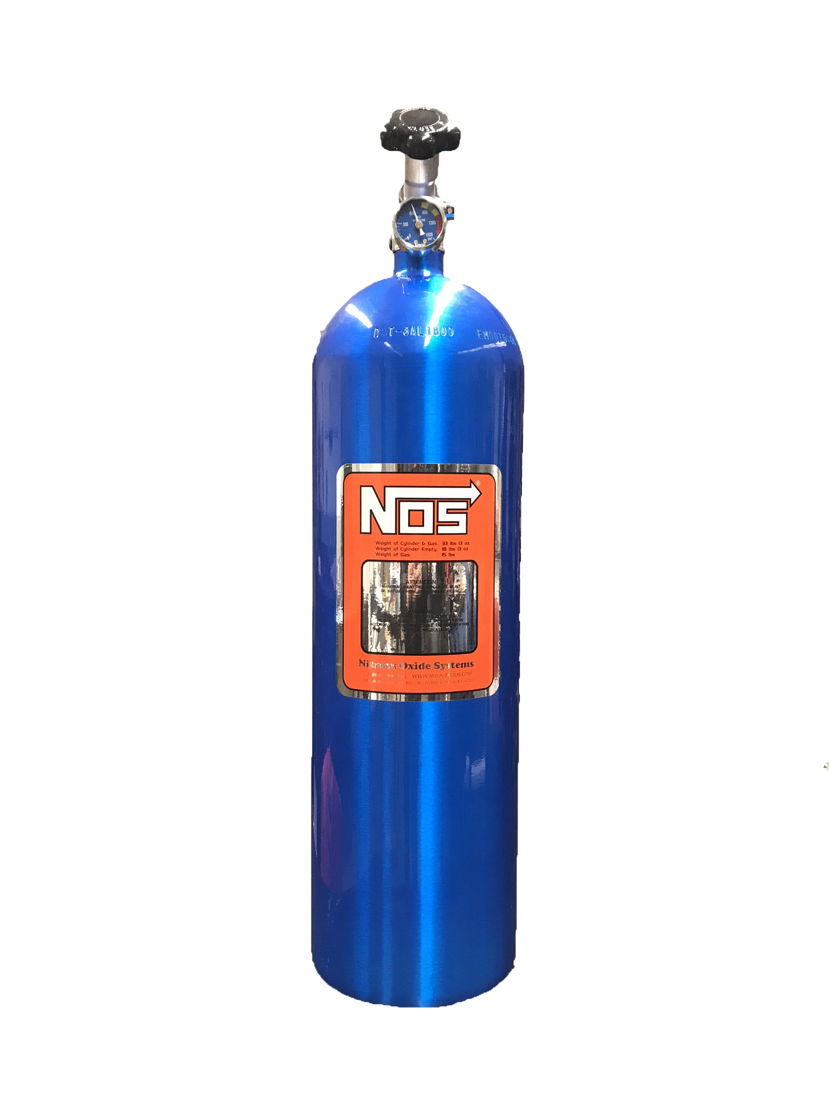



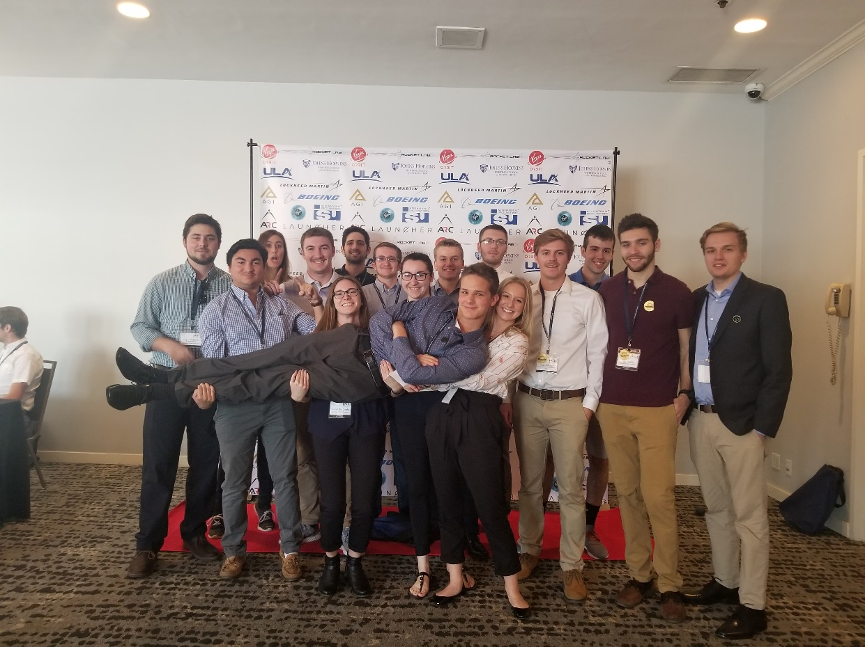
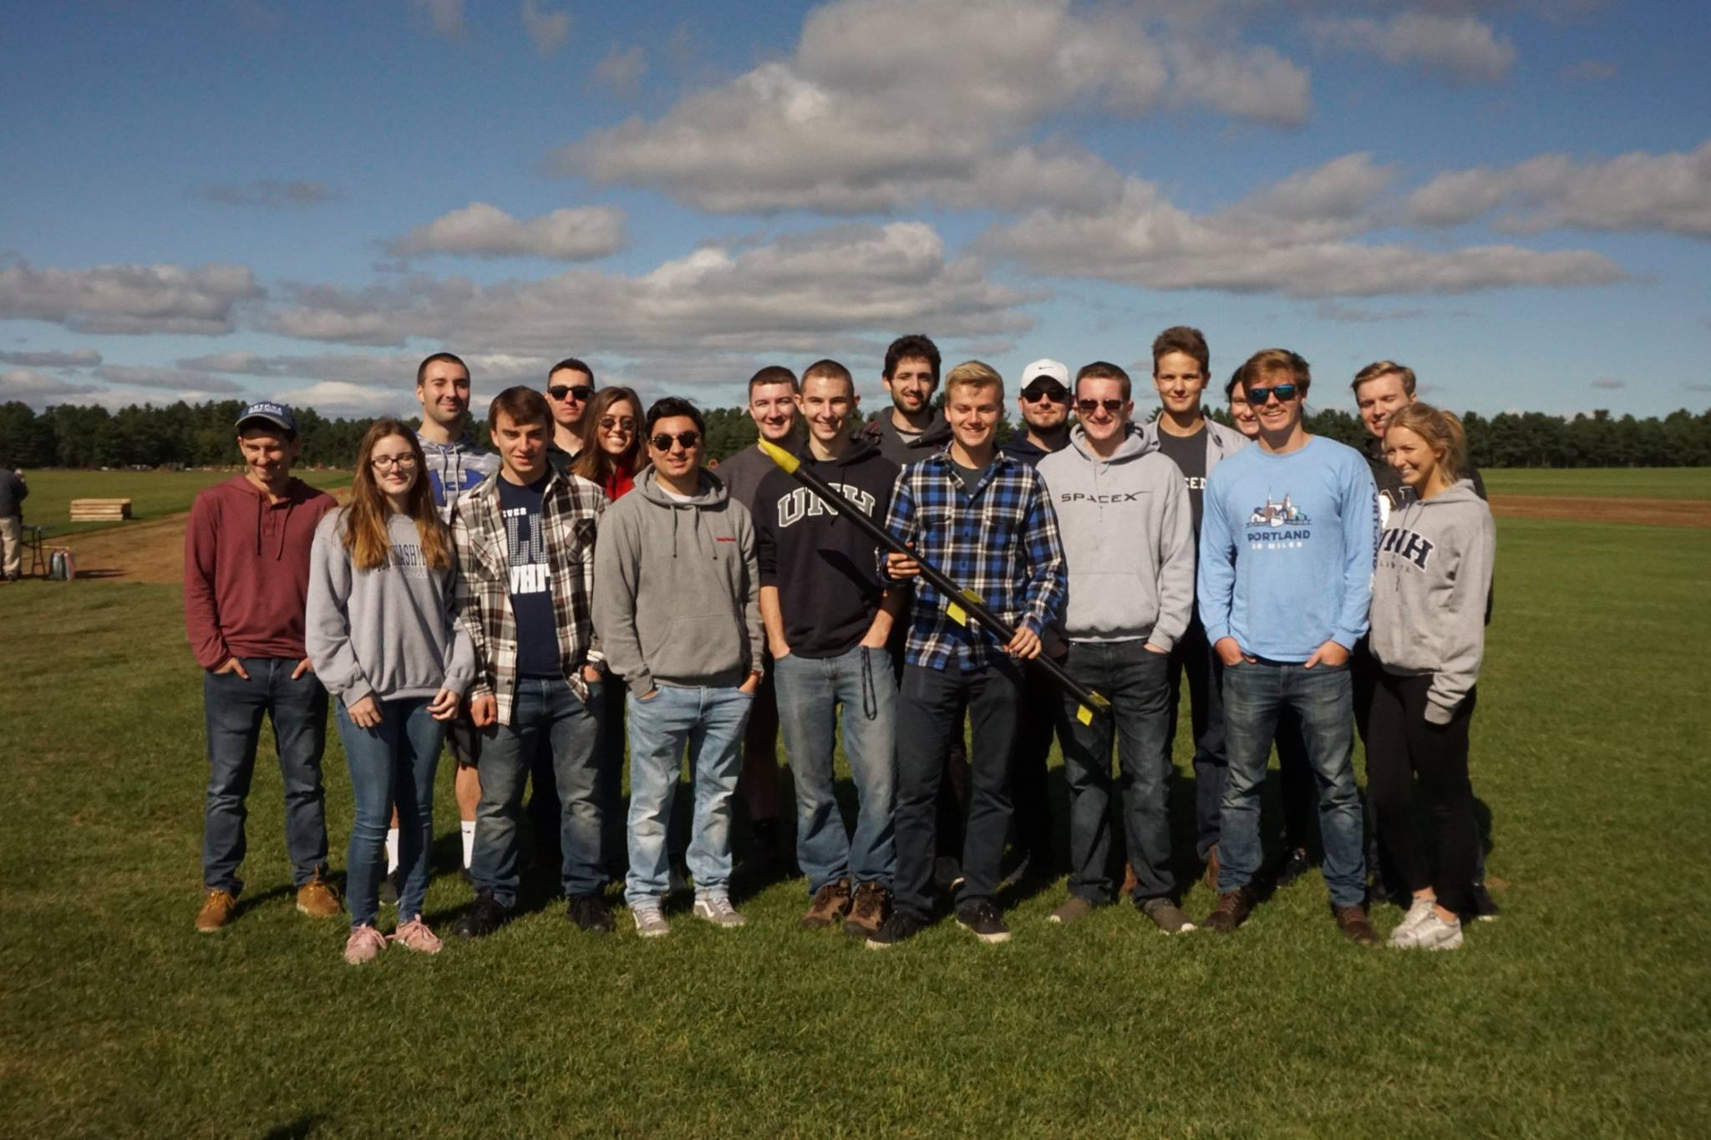
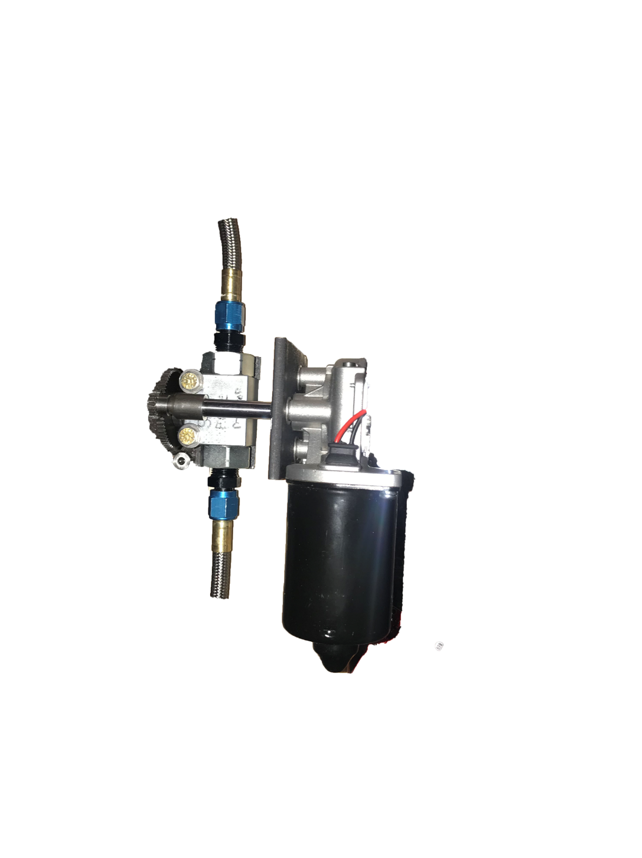
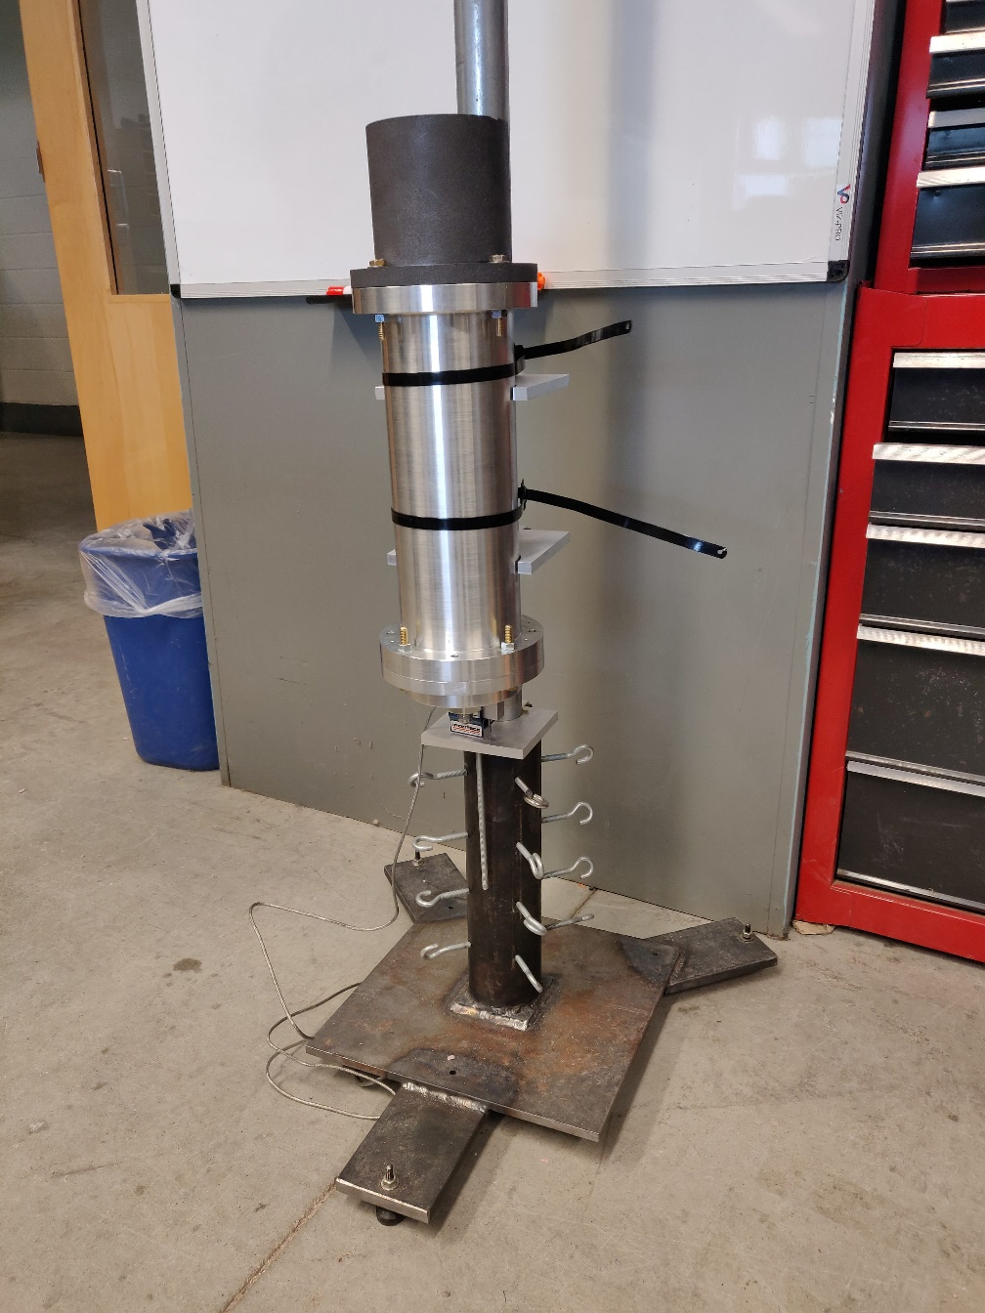
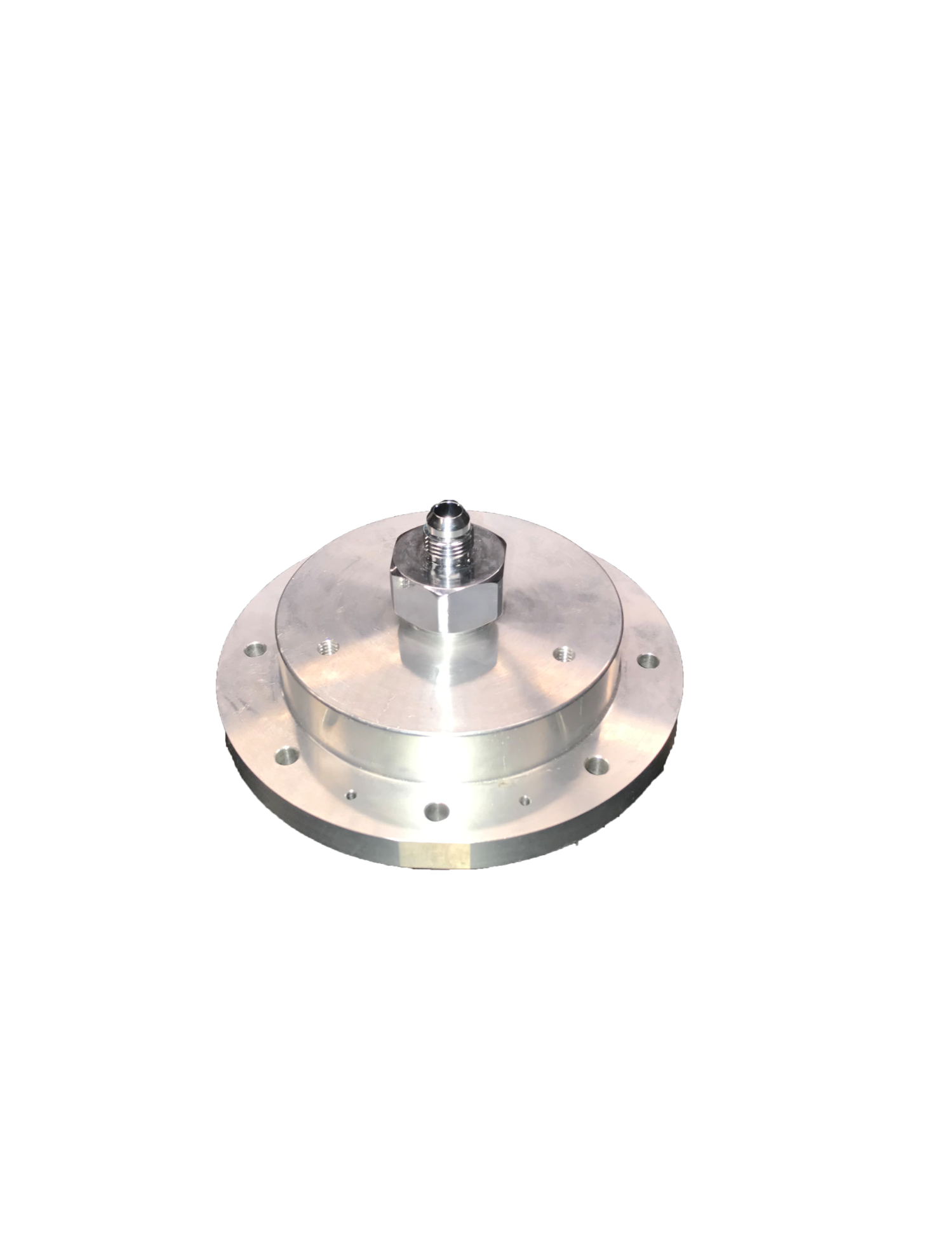
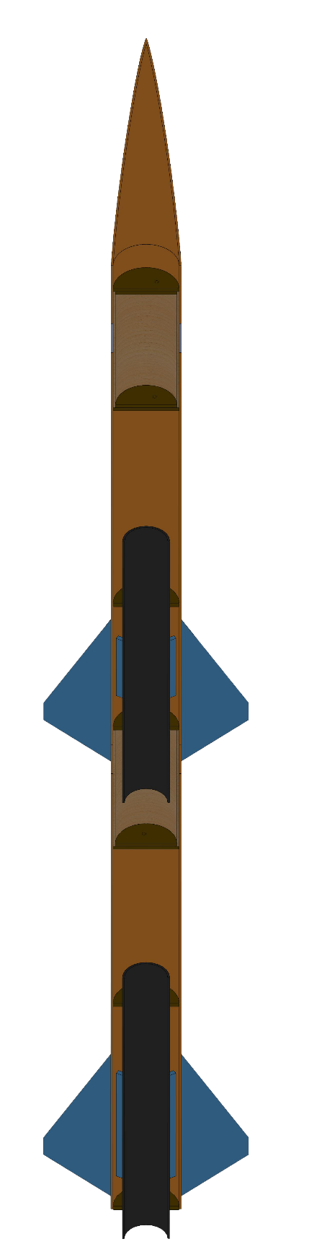
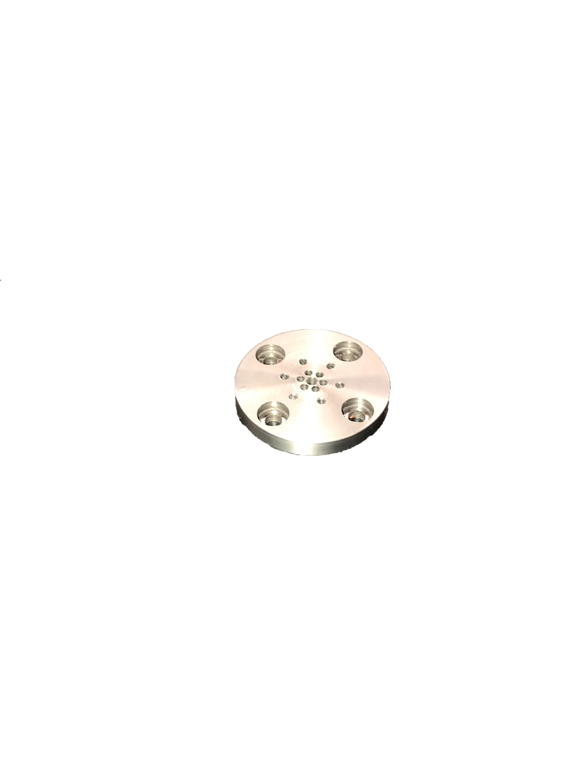


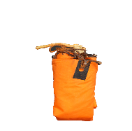
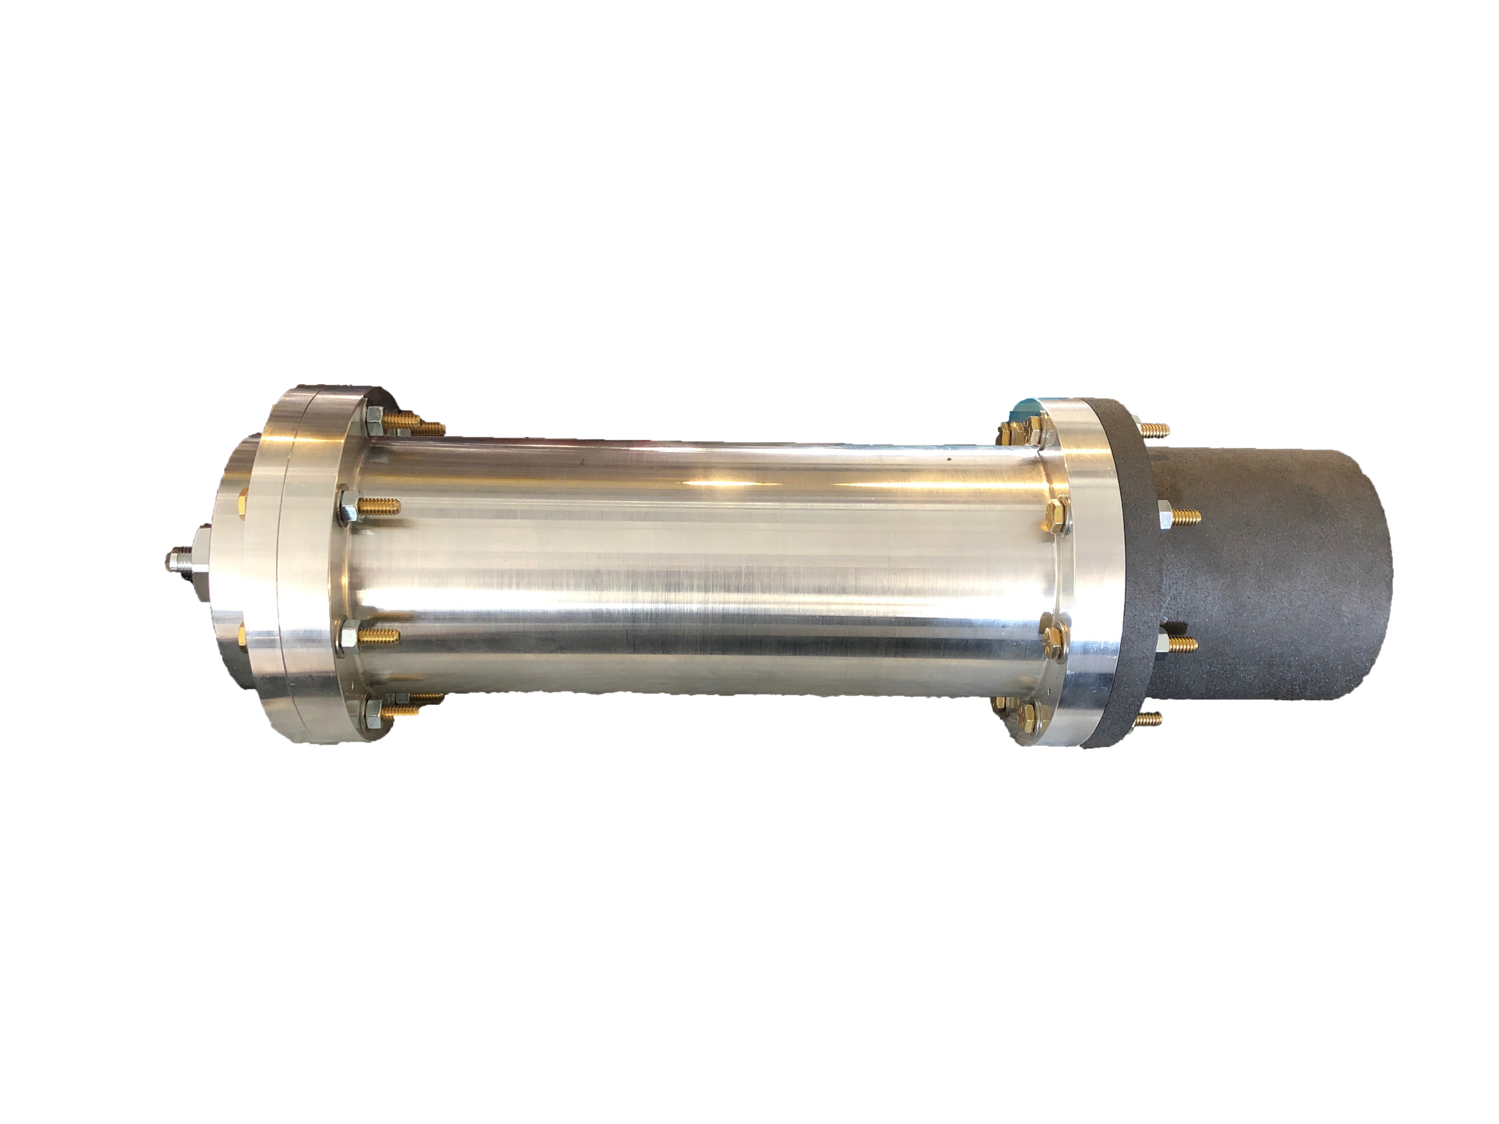
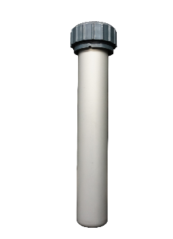
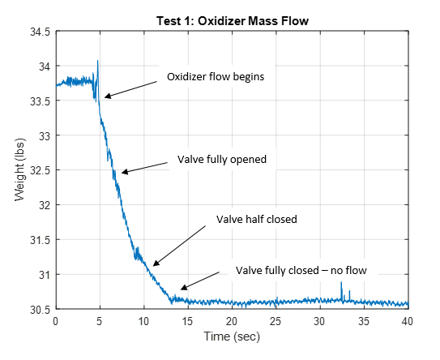
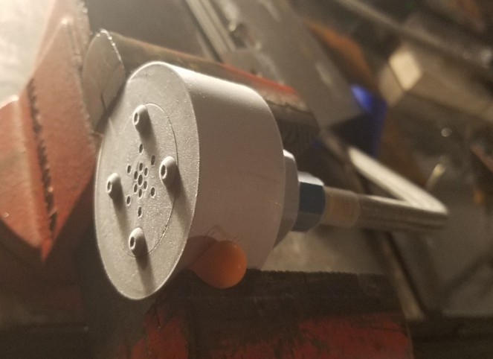
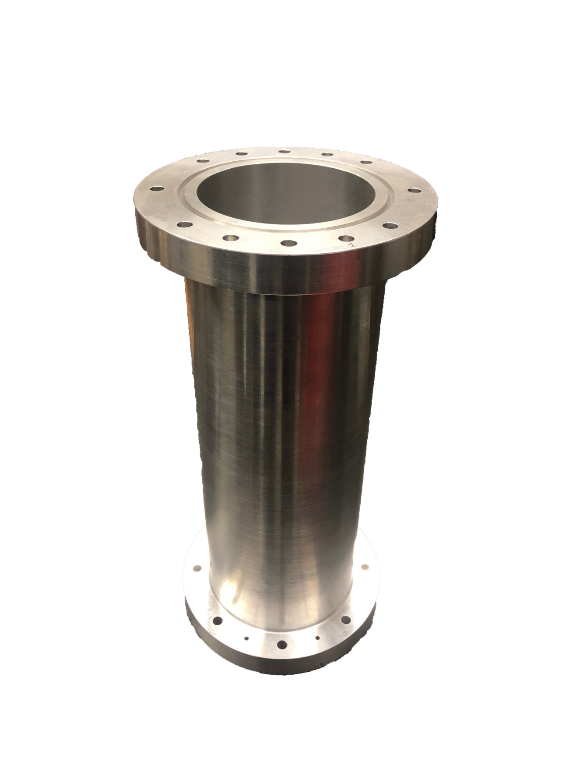
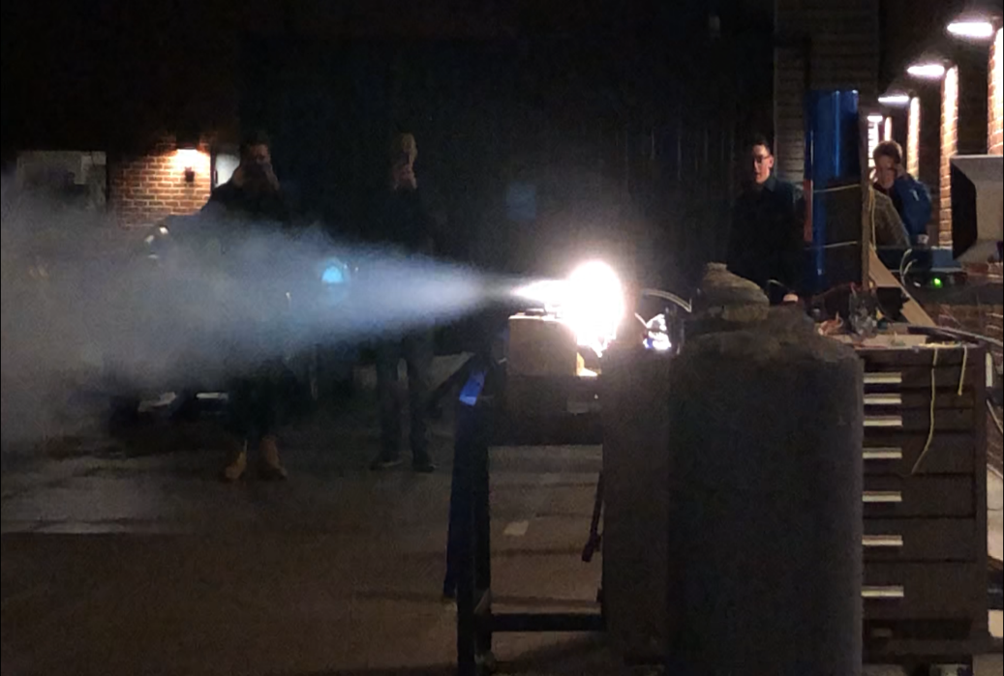

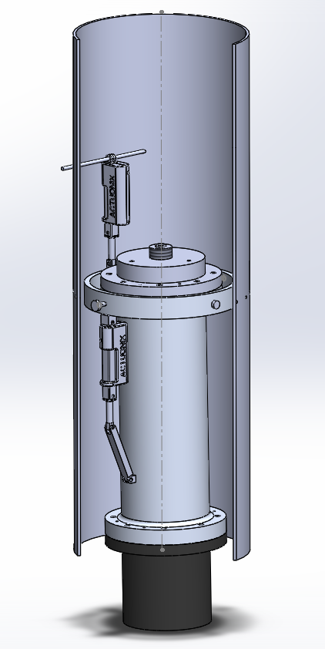

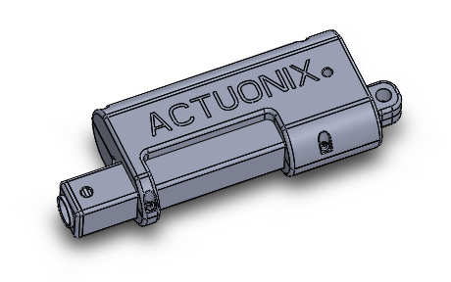
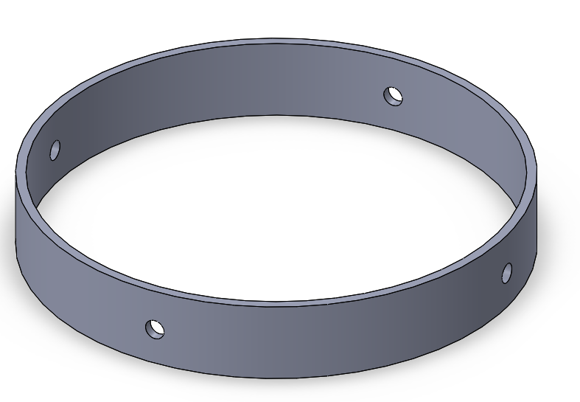
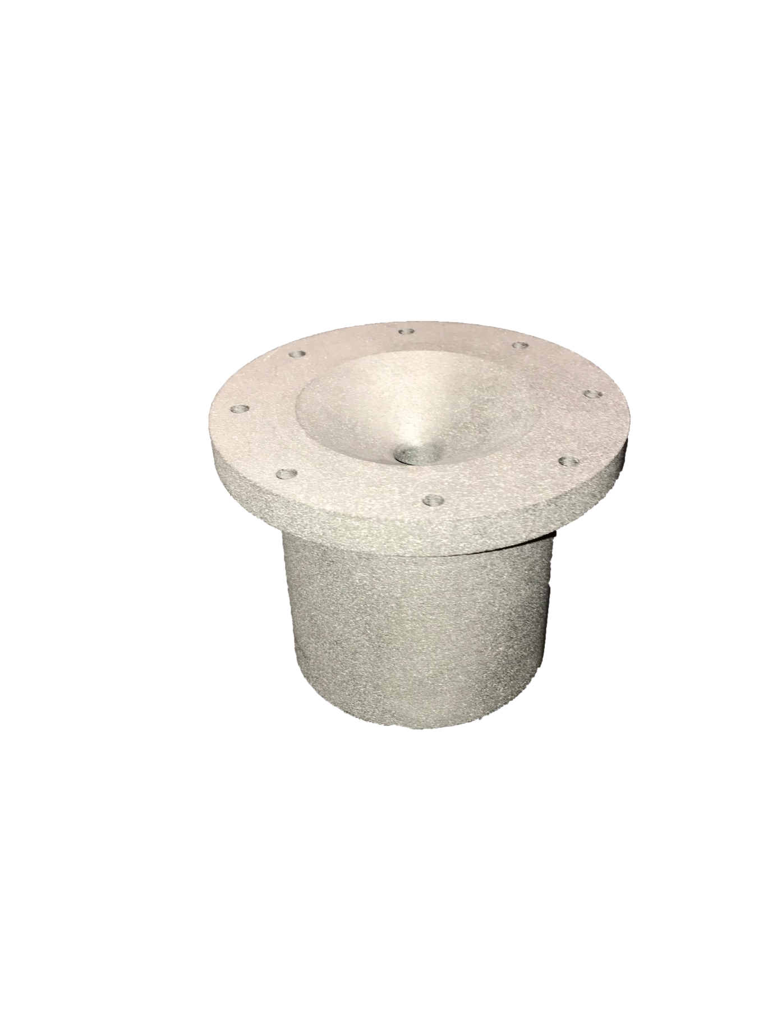

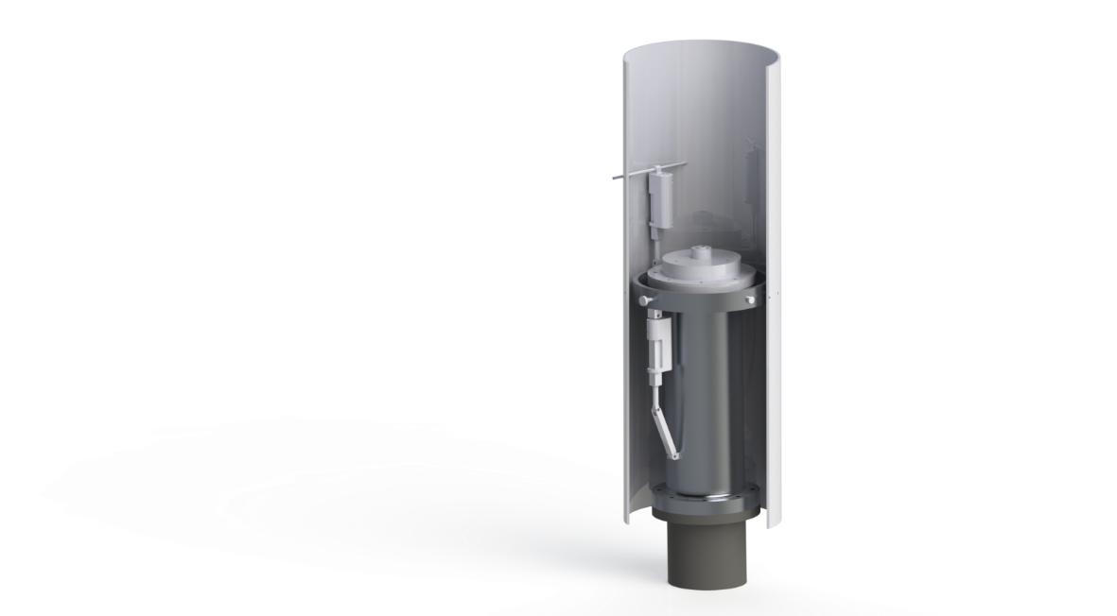
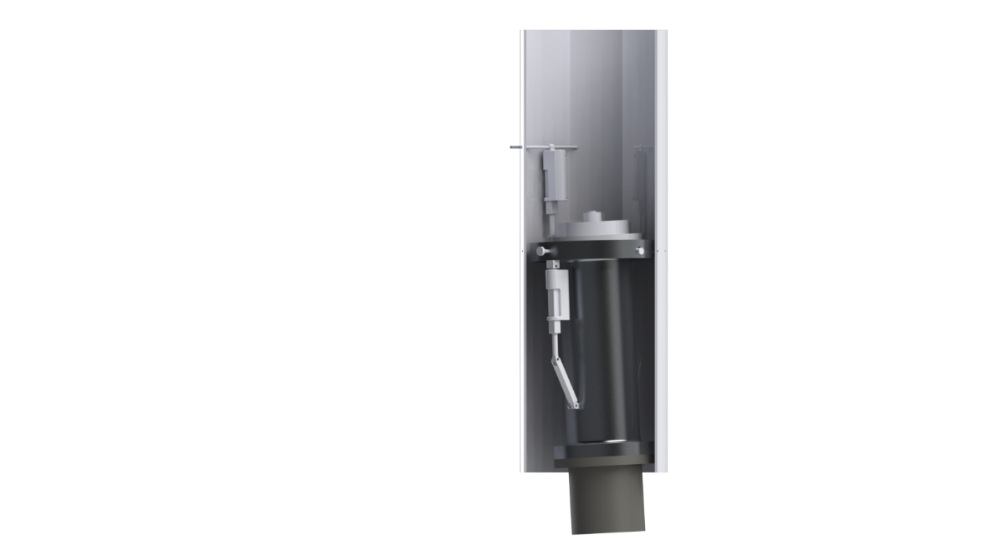
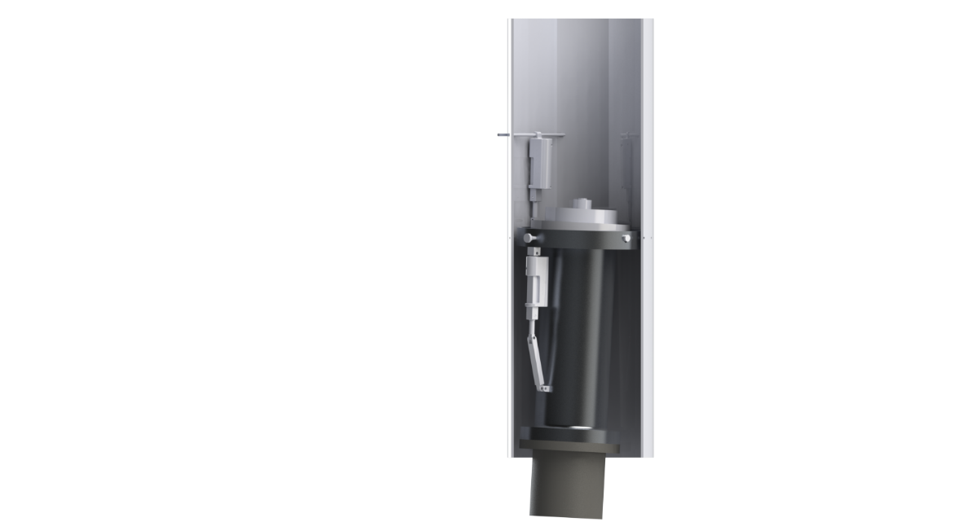
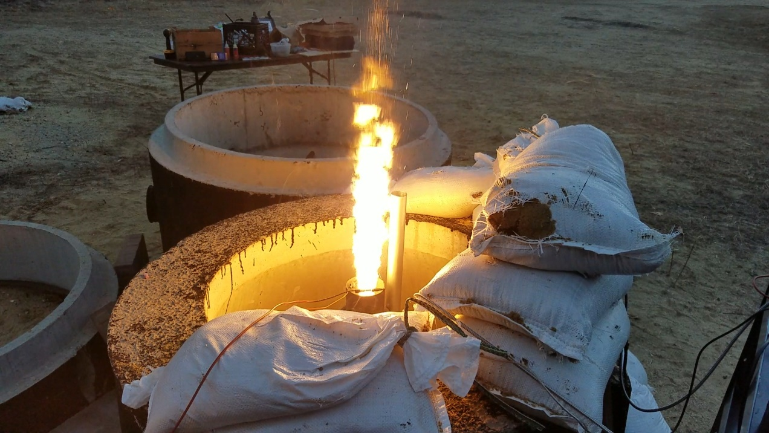
Department of Mechanical Engineering
Authors: Charlie Nitschelm, Andrew Hosman, Collin Stroshine, Ryan Blatti, Chase Eldridge, Tyler Landry, John Langer, Thomas Collins, Silas Johnson
Advisor: Dr. Todd Gross
Who We Are
A second year engineering organization comprised of students of all classes and CEPS majors
A primary engineering goal of pursuing the art of high power rocketry with custom-made hybrid engines
Fuel Selection and Flow Regulation
Hydroxyl-terminated polybutadiene (HTPB) and liquid nitrous oxide were chosen as the reducer and oxidizer, respectively.
A mold was 3-D printed to insert into the combustion chamber to form the HTPB into a circular grain.
The flow regulator controls the amount of flow into the combustion chamber, permitting throttle, cutoff, and reignition
Oxidizer Tank
A highly pressurized vessel that
contains liquid Nitrous Oxide,
acting as our oxidizer within
the combustion chamber
Vertical Static Test Fire Rig
Flow Regulator
A motorized valve that monitors flow regulation
of the oxidizer into the injection plate controlled
by an electric motor and
an Arduino.
Engine Startup / Ignition Method
Correct ignition method to start-up the engine and provide initial heat and pressure for further combustion with the oxidizer
Obtain an initial injector flow rate
Hot Fire Testing Rig and Data Collection
Used to safely test the hybrid rocket engine in a static rig
Collect precise data on thrust, mass flow rate and combustion temperature for future optimization of the hybrid rocket engine geometry
SpaceVision, November 2018
SEDS Rocketry Competition, October 2018
Injection Plate
Responsible for providing desired oxidizer flow into the combustion chamber with the assistance of the impinging plate
The 3 Year Plan
Year One
Year Three
Oxidizer Injection
A cold test fire was conducted to examine the oxidizer flow through the injector insert, and to determine the mass flow rate
Tested the flow regulation system
Attempted to determine how far we must open the flow regulator in order to get optimal flow through the injector plate
Hybrid Engine
Design
Manufacture
Test
Gimbal System
Preliminary design work was started last year on commercial off the shelf 29mm engines to assist in the application of those techniques on a larger, homemade hybrid engine
HHHHH
Impinging Plate
An interchangeable cylindrical plate responsible for the impingement and atomization of the oxidizer flow streams
Runaway
Two actuators will be utilized to control the pitch and yaw of our thrust vector through flight
An accelerometer will be used to sense any variation in our zenith direction, and quickly redirect our engine thrust to return back to the desired flight path
Rocket Building
Simulating
Launching
Optimizing
Hybrid Rocket
Engine Optimization
Rocket Integration
Competition
Combustion Chamber
An enclosed volume where the solid reducer and liquid oxidizer react to produce a superheated, highly pressurized chamber of gas
Year Two
Combustion and Ignition
A cold test fire was conducted to examine the oxidizer flow through the injector insert, and to determine the mass flow rate
Tested the flow regulation system
Attempted to determine how far we must open the flow regulator in order to get optimal flow through the injector plate
Hot Fire Test
Improvements will be made to the oxidizer flow system to ensure reliable throttling.
Future steps, repeat ignition, data collection, and safety protocols for further tests.
Nozzle
Graphite was machined into a de Laval curve responsible for directing the flow of hot gases outside of the combustion chamber into the environment providing thrust
Thrust Vectoring
Current Work
A gimbal ring is used to provide a second rotational piece that is placed between the engine and the rocket body
Two actuators positioned 90 degrees apart enable pitch and yaw control
Acknowledgments
A huge thanks to all the members of UNH SEDS, Scott Campbell, Dr. Ivo Nedyalkov, Dr. Alireza Ebadi, Sheldon Parent, Chief Dean, Ronald O’Keefe, TURBOCAM International, Reilly Webb, the UNH Makerspace and our advisor Dr. Todd Gross for all the support

Slide 2
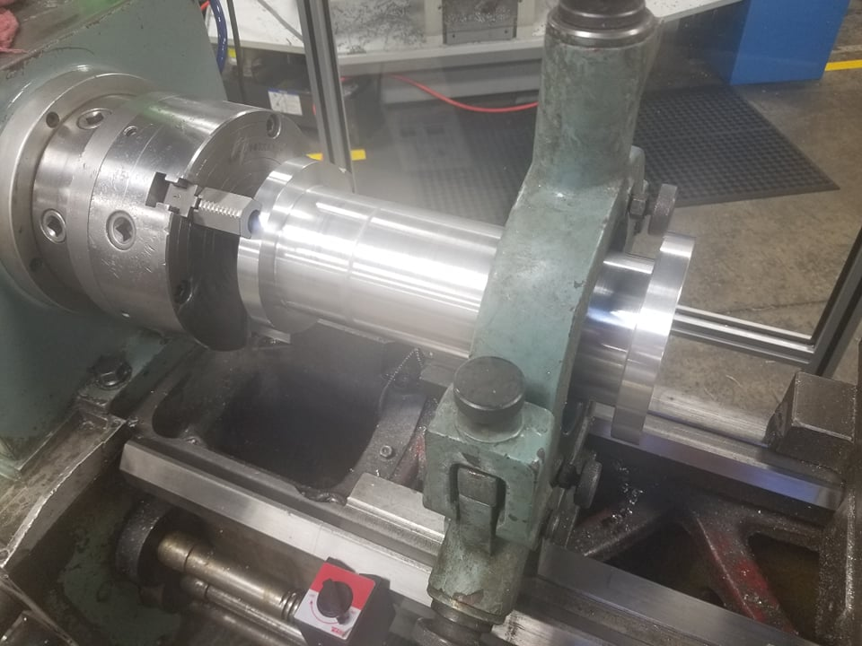
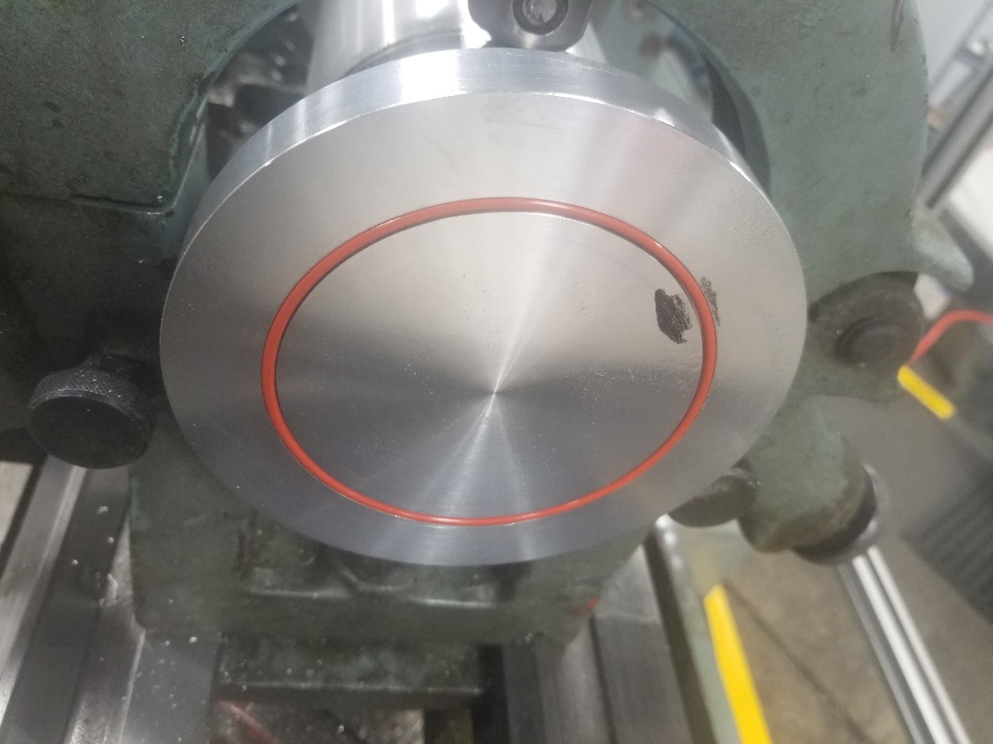
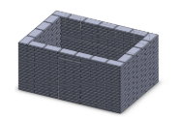
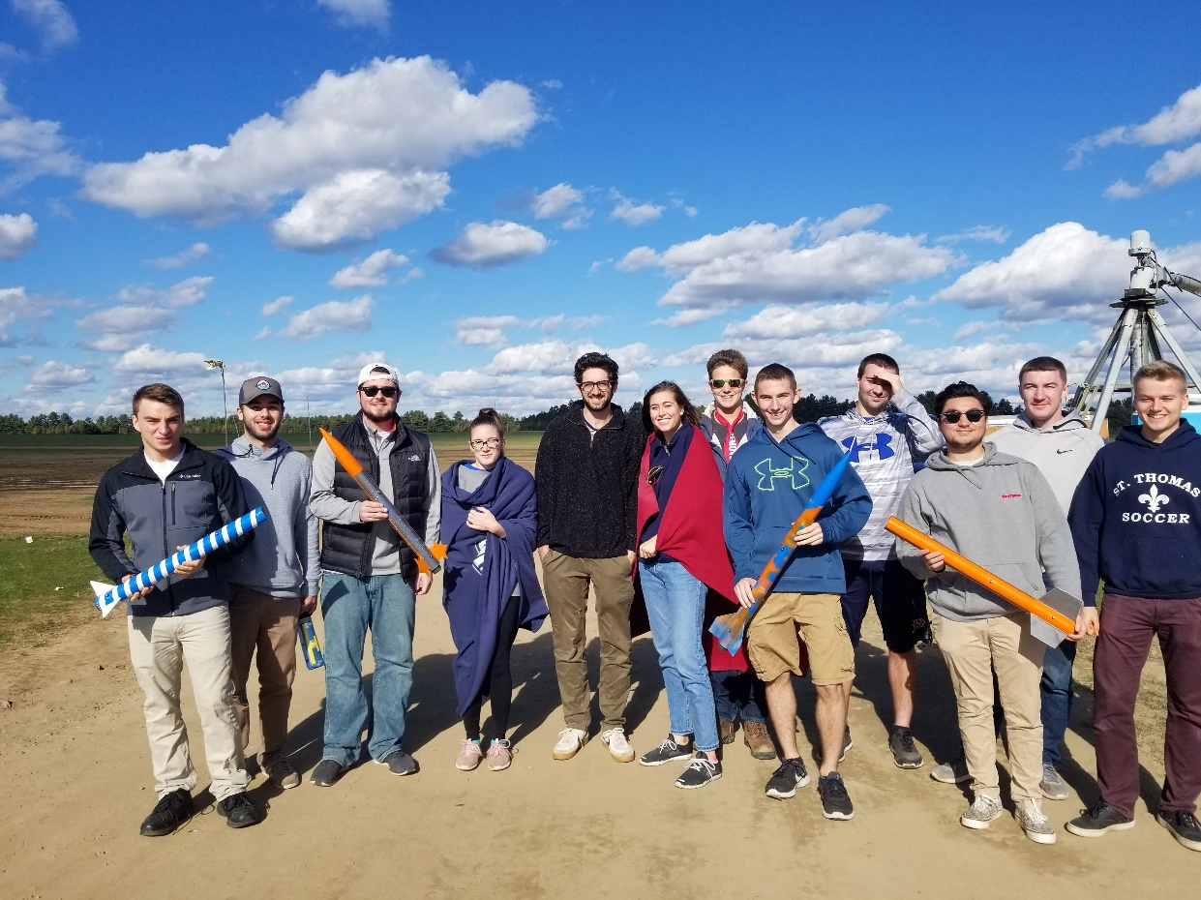
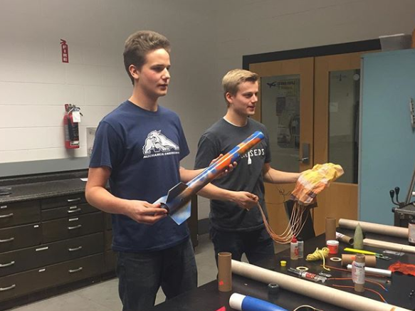
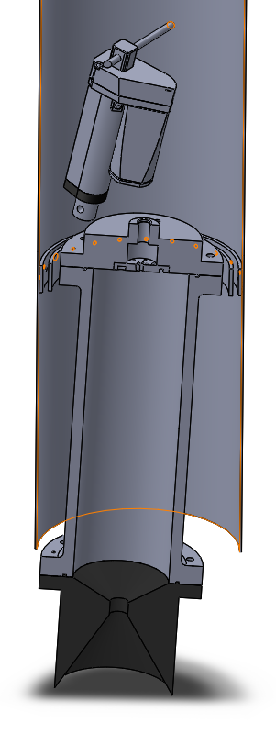
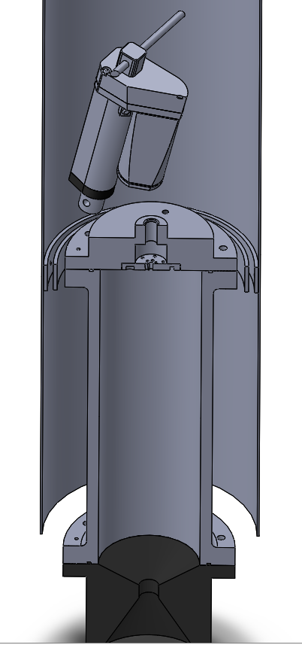
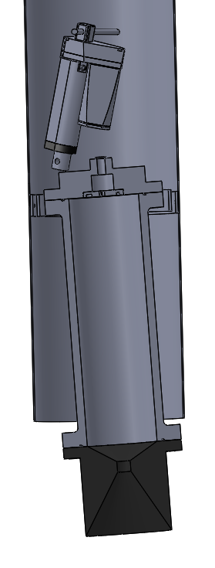
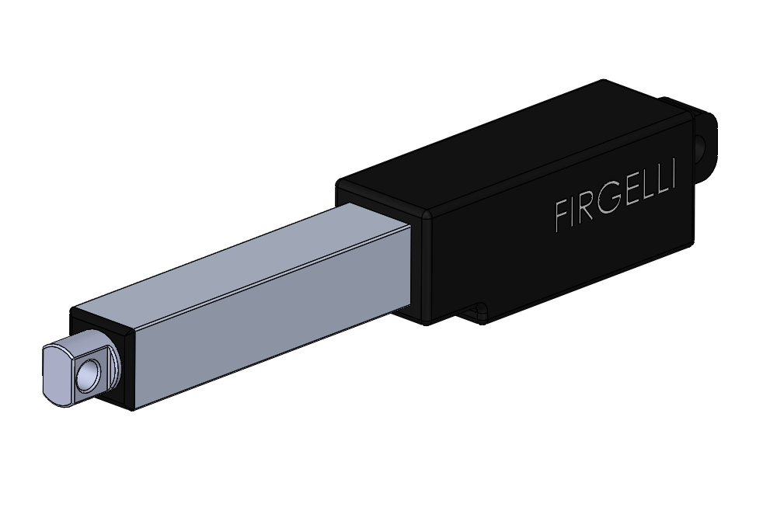
Department of Mechanical Engineering
Authors: Charlie Nitschelm, Andrew Hosman, Collin Stroshine, Ryan Blatti, Chase Eldridge, Tyler Landry, John Langer, Thomas Collins, Silas Johnson
Advisor: Dr. Todd Gross
Who We Are
A chapter of the Students for the Exploration and Development of Space, part of a nationwide organization
A second year engineering organization comprised of students of all classes and CEPS majors
A primary engineering goal of pursuing the art of high power rocketry with custom-made hybrid engines
Focused on giving its members a unique experience in the design and manufacturing of rockets and rocket engine components
Manufacturing
The combustion chamber and Injector plate were manufactured with the assistance of TURBOCAM International
Both components made of Aluminum 6061 for ease of manufacturing and Tripoli Experimental Rocket Recommendations
Injector plate designed so the plate can be reused, but hole inserts can be redesigned and replaced
The nozzle was manufactured here at UNH by Scott Campbell
Oxidizer Tank
A highly pressurized vessel that
contains liquid Nitrous Oxide,
acting as our oxidizer within
the combustion chamber
Flow Regulator
A motorized valve that monitors flow regulation
of the oxidizer into the injection plate controlled
by an electric motor and
an Arduino.
Injection Plate
Responsible for providing desired oxidizer flow into the combustion chamber with the assistance of the impinging plate
Cold Fire Test
A cold test fire was conducted to examine the oxidizer flow through the injector insert, and to determine the mass flow rate
Tested the flow regulation system
Attempted to determine how far we must open the flow regulator in order to get optimal flow through the injector plate
Project Overview
Our main focus is to develop a rocket propelled by a student designed hybrid engine
A hybrid rocket engine uses a solid reducer with the assistance of a liquid oxidizer
Compete in the Spaceport America Cup in June 2020 hosted in Las Cruces, New Mexico
A 10,000 ft. apogee competition implementing a student researched and developed hybrid class engine
Design and implement a device to enable the gimbaling of our hybrid rocket engine to control flight dynamics in real time
Impinging Plate
An interchangeable cylindrical plate responsible for the impingement and atomization of the oxidizer flow streams
Combustion Chamber
An enclosed volume where the solid reducer and liquid oxidizer react to produce a superheated, highly pressurized chamber of gas
Rocket Building Techniques
To begin designing and manufacturing a rocket engine, it is crucial to understand overall rocket design, mechanics and manufacturing techniques
Utilized last years members to teach and mentor new members on the lessons learned from last years research
Hosted multiple building sessions and in-house competitions to compete on highest altitude achieved
Learned the fundamental parameters that affect the performance of a rocket in flight, and tested first hand the effect of these design choices on the overall flight performance and path.
Project Field Safety
Must obtain a suitable location and testing infrastructure for safe testing procedures and events by communicating and negotiating with local officials
Design certain field structures needed for the development of testing and launching semi-permanent buildings
Nozzle
Graphite was machined into a de Laval curve responsible for directing the flow of hot gases outside of the combustion chamber into the environment providing thrust
Hot Fire Test
Engine Startup / Ignition Method
Correct ignition method to start-up the engine and provide initial heat and pressure for further combustion with the oxidizer
Obtain an initial injector flow rate
Hot Fire Testing Rig and Data Collection
Used to safely test the hybrid rocket engine in a static rig
Collect precise data on thrust, mass flow rate and combustion temperature for future optimization of the hybrid rocket engine geometry
Gimbal System
Preliminary design work was started last year on commercial off the shelf 29mm engines to assist in the application of those techniques on a larger, homemade hybrid engine
HHHHH
Two actuators will be utilized to control the pitch and yaw of our thrust vector through flight
An accelerometer will be used to sense any variation in our zenith direction, and quickly redirect our engine thrust to return back to the desired flight path
Reducer and Oxidizer
The fuel selected is Hydroxyl-terminated polybutadiene (HTPB), a commonly used hybrid reducer.
Liquid Nitrous Oxide was chosen as the oxidizer as it is commonly paired with HTPB and provided us with a great baseline of public knowledge
A mold was 3-D printed to insert into the combustion chamber and form the rubber to a specific grain formation in preparation for combustion and radial burn rate
Acknowledgments
A huge thanks to all the members of UNH SEDS, Scott Campbell, Dr. Ivo Nedyalkov, Dr. Alireza Ebadi, Sheldon Parent, Chief Dean, Ronald O’Keefe, TURBOCAM International, Reilly Webb and our advisor Dr. Todd Gross for all the support

Slide 3
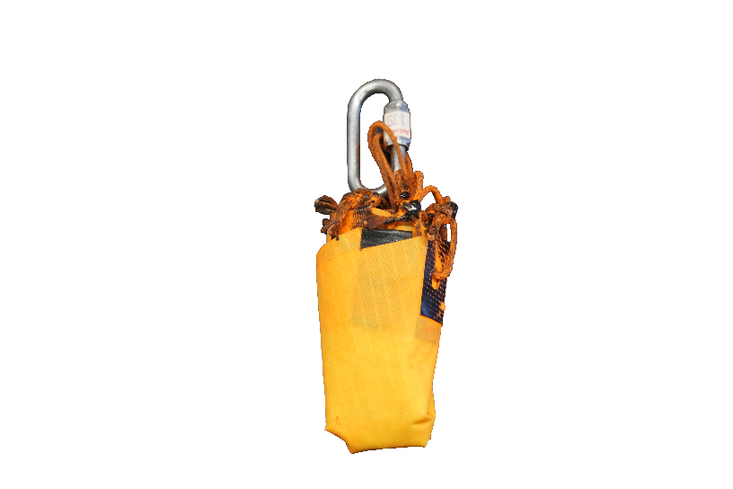
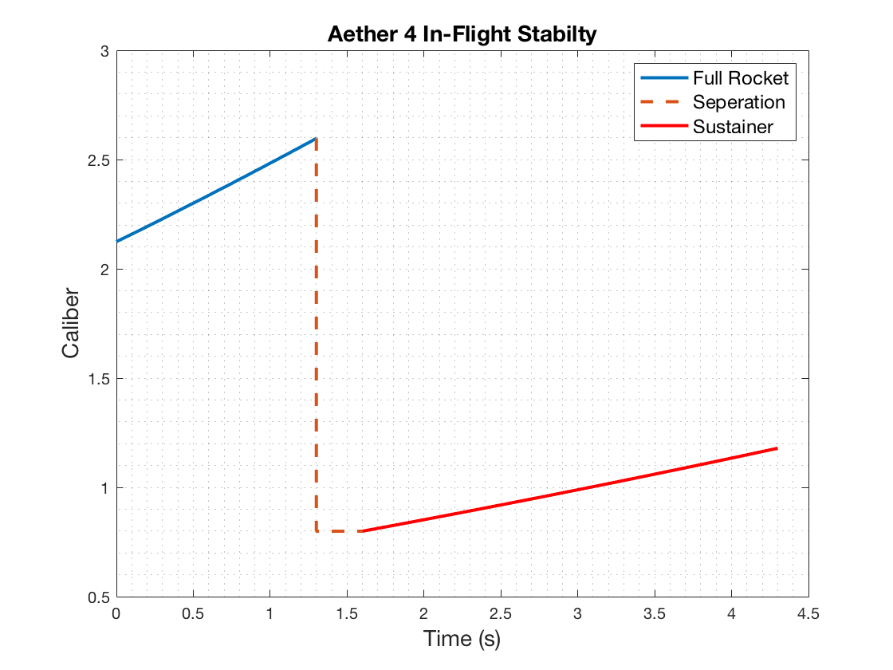
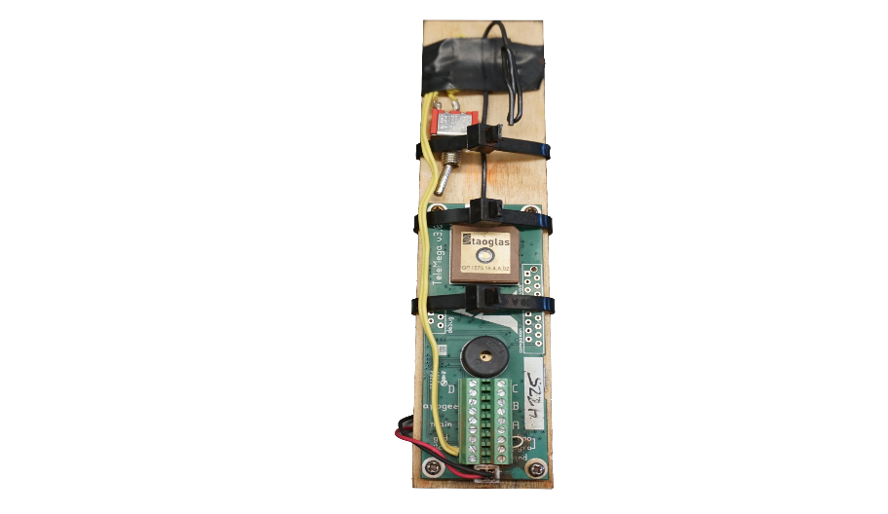
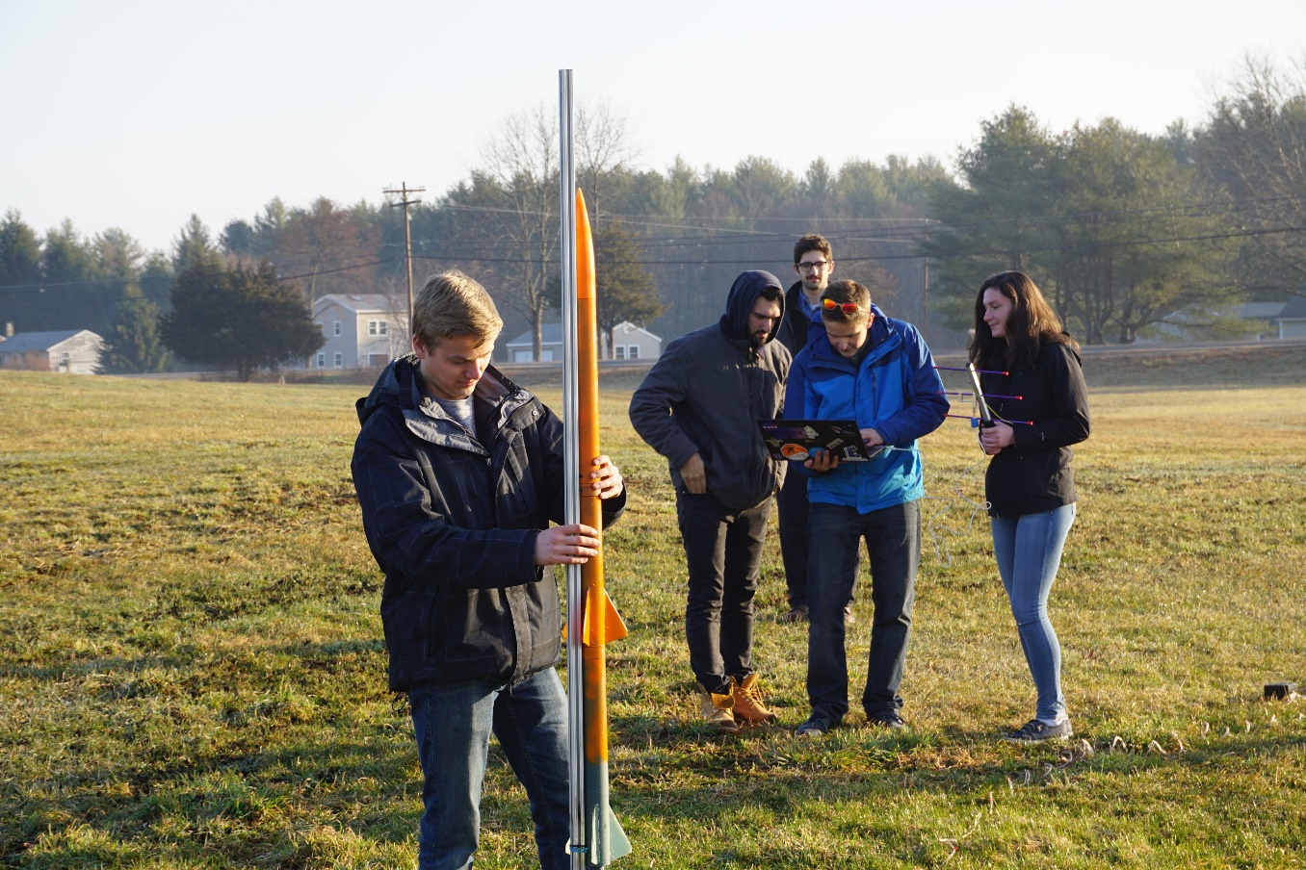
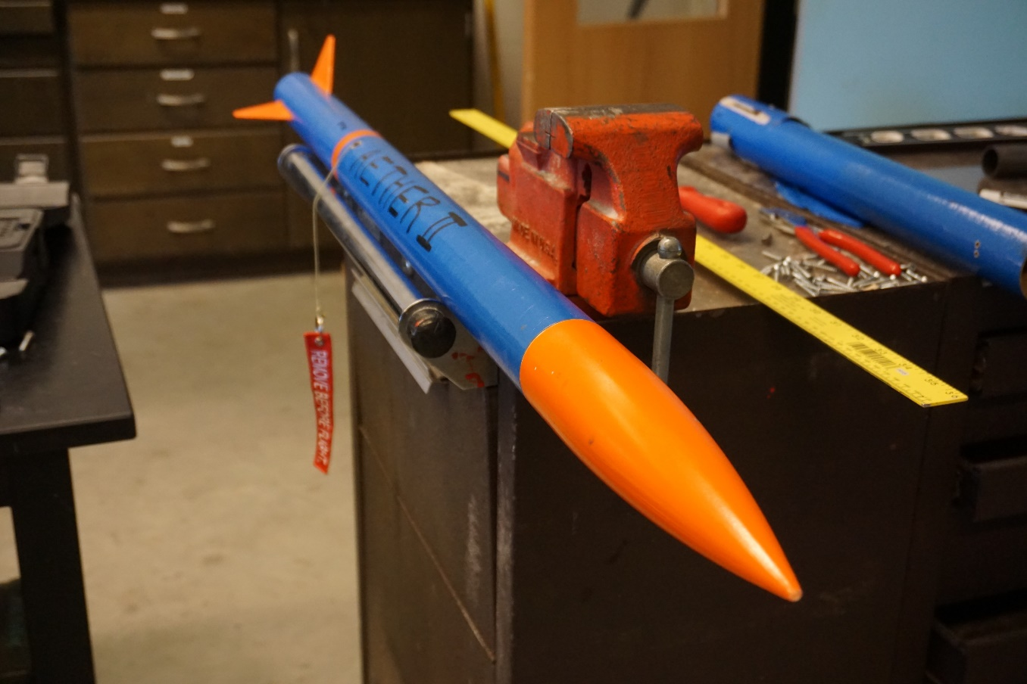


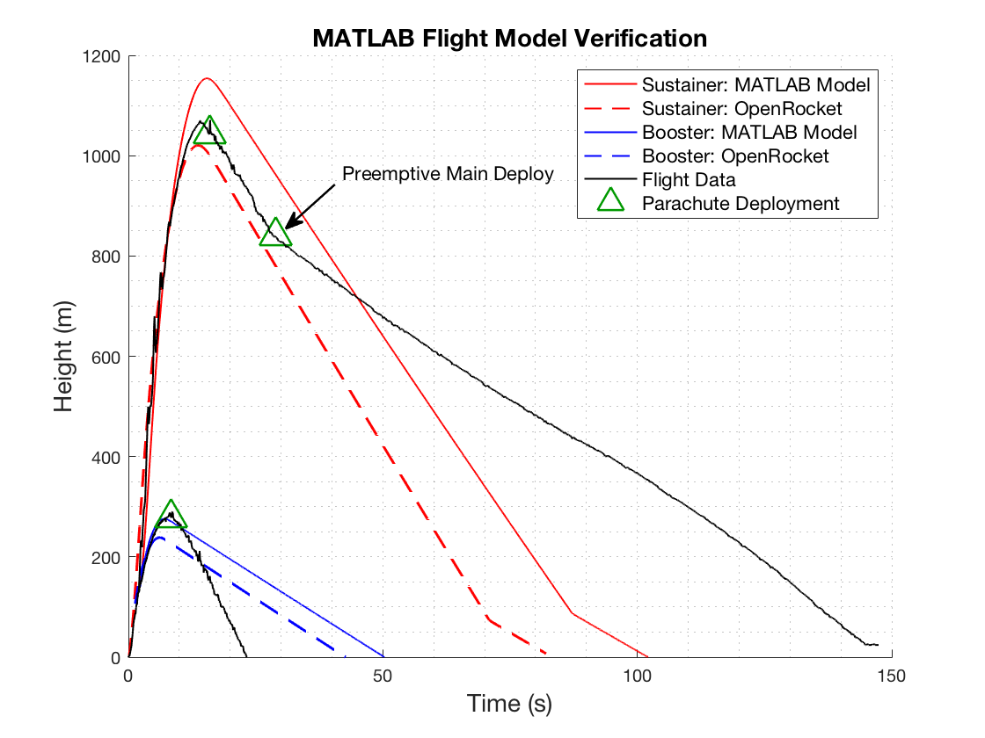
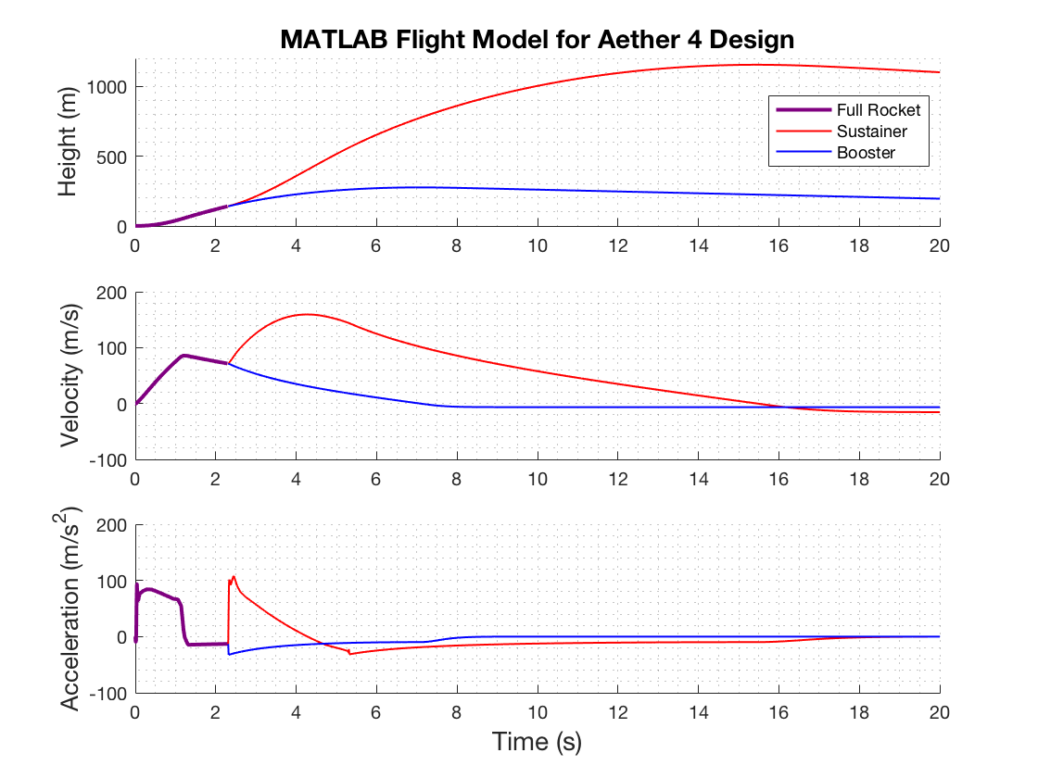
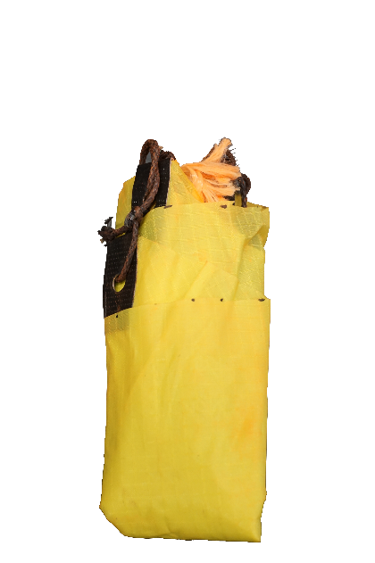

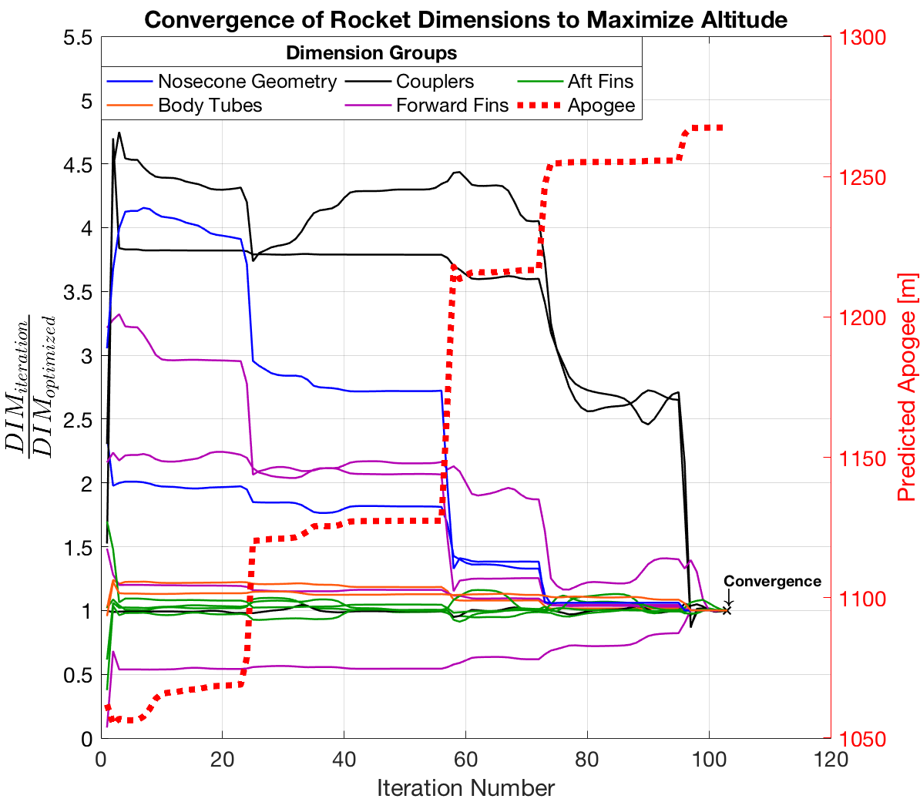
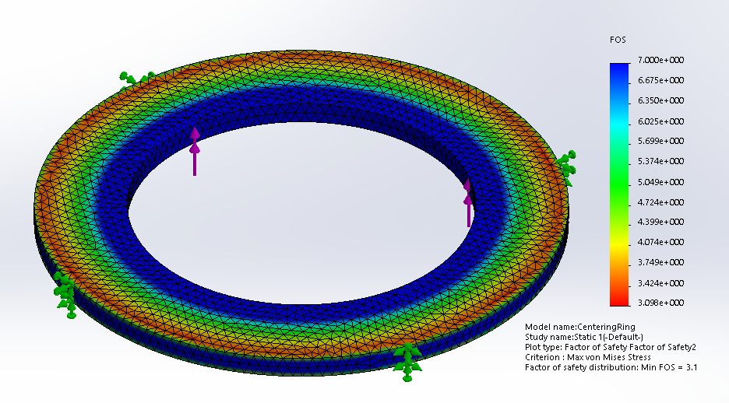
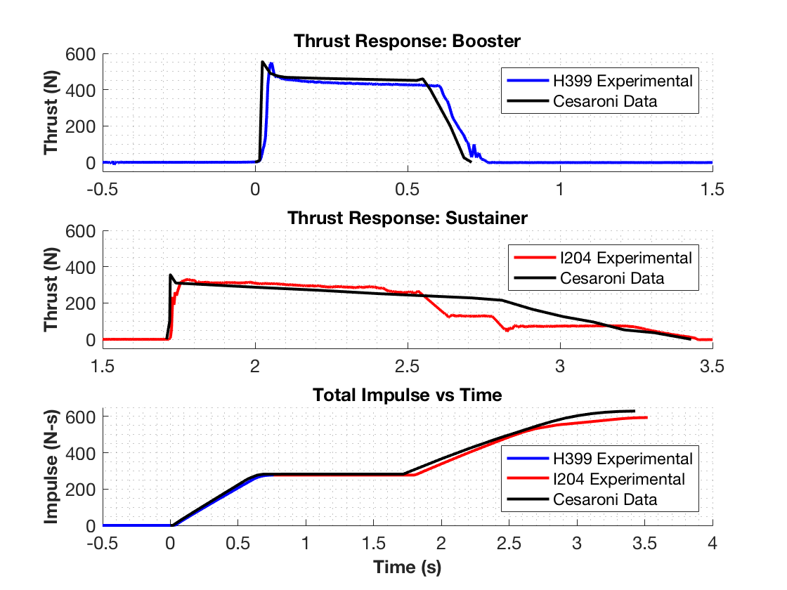
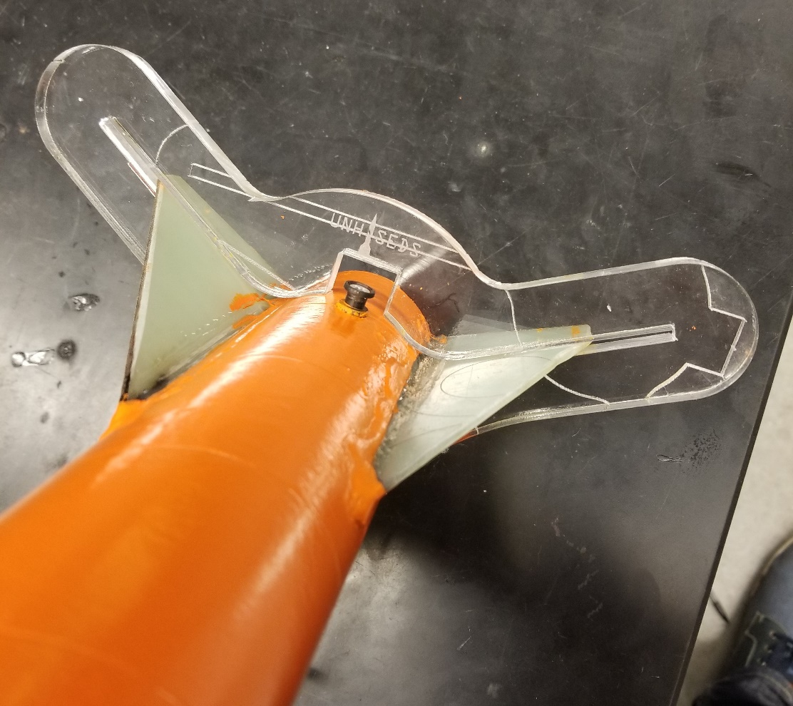
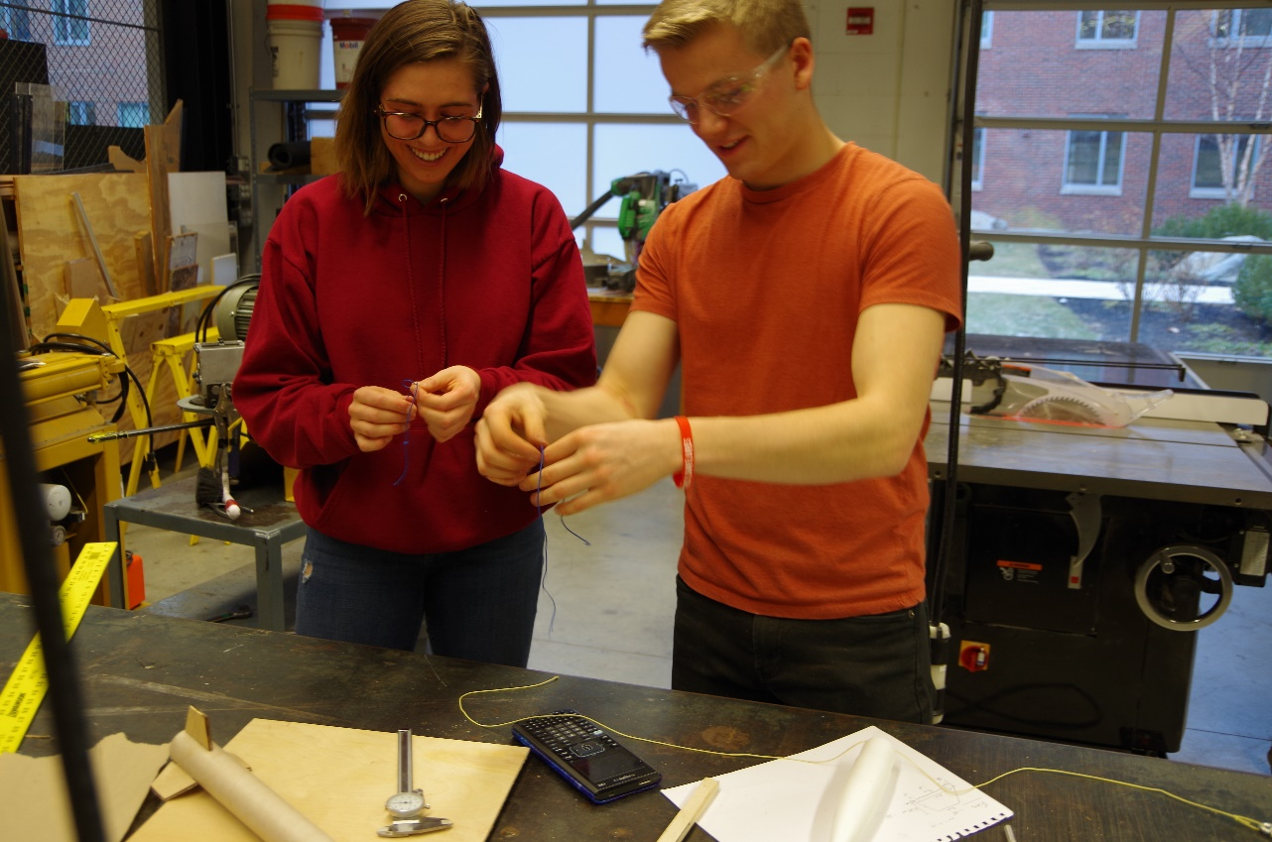
Department of Mechanical Engineering
Authors: Charlie Nitschelm, Kevin Bucher, Nick Clegg, Reilly Webb
Advisor: Dr. Todd Gross
Project Overview
To design, manufacture, and launch a high-powered, multi-stage rocket for the SEDS University Student Rocketry Competition
Goals
Design a high-powered engine class rocket to achieve maximum altitude
Implement a comprehensive recovery system that results in a fully reusable rocket
Constraints
Total combined engine impulse must not exceed 640.0 N-s
Must have at least two propulsion stages
Drogue Parachute
A small parachute deployed at sustainer apogee
Launch Simulation
Custom Nose Cone
A carbon fiber nose cone that houses the drogue parachute and connects directly to the electronics bay
Rocket trajectory was simulated using MATLAB. This required accurate stability, thrust, drag, and atmospheric models to produce ordinary differential equations that are then numerically solved for given rocket dimensions
Caliber is a measure of passive stability, and should remain between 1-3 for stable flight (right)
Electronics Bay
Houses the TeleMega GPS and controls both parachute deployment and sustainer ignition
Sustainer Parachute
A larger main parachute that
slows the sustainer to a safe landing speed
The MATLAB flight model is verified by comparing results to flight data from launches and to OpenRocket predictions (a pre-existing rocket simulation program)
 | Flight Data | OpenRocket Model | MATLAB Model
Sustainer Apogee | 1071.1 m | 1020.6 m | 1154.1 m
Booster Apogee | 290.0 m | 238.6 m | 276.3 m
Sustainer Engine
Propels the rocket to max altitude after booster burnout; 1.7 second burn time
Forward Fins
Provides stability to
the sustainer after stage separation
Check Integrity with Finite Element Analysis
Research Aerodynamic Theory
Optimize Rocket Dimensions
Staging Coupler
Supports stage separation at sustainer ignition
Manufacture and Assemble
Booster Parachute
A large parachute to slow the
booster to a safe landing speed
Improve
Aerodynamic Models
Rocket Improvement Cycle
Design & Analysis
An optimization program was created to determine the nominal dimensions for each component that will result in the highest simulated altitude.
An optimization program was created to determine the nominal dimensions for each component that will result in the highest simulated altitude
Launch and Gather Data
Booster Engine
Initiates flight with a
0.7 second burn time
Improve Manufacturing Techniques
Aft Fins
Provides stability to the rocket before stage separation
This was achieved by maximizing the height output from the combined aerodynamic models through nonlinear programming using the interior-point algorithm
Improve Field Launch Techniques
Propulsion
A Static Test Fire Rig was designed and manufactured to test the propulsion characteristics of each engine and to verify total engine impulse stays below 640.0 N-s
Optimization Constraints:
Maintain in-flight stability
Structural integrity factor of safety of at least 3.0
Manufacturing limitations
 | Reported Max Thrust | Measured Max Thrust | Reported Total Impulse | Measured Total Impulse
Booster Engine: Cesaroni H399 | 545.8 N | 549.6 N | 282.2 N-s | 277.1 N-s
Sustainer Engine: Cesaroni I204 | 356.8 N | 329.7 N | 347.7 N-s | 322.7 N-s
Manufacturing
Stress analyses are performed on the optimized components that are prone to failure, such as the engine centering ring (left)
A laser cut fin alignment tool was designed to keep fins in place during the epoxy curing process
Many components are assembled from scratch such as the nosecone, fins, ignition leads, ejection charges, and launch pad
Data acquisition was performed using the custom test rig, a 150 lb load cell, and NI SignalExpress software
Results were verified by comparing to official data reported by the engine manufacturer
Optimization must be reconfigured if resulting FOS is less than 3.0
Acknowledgments
A huge thanks to all the members of UNH SEDS, Prof. Martin Wosnik, Alireza Ebadi, Thomas Collins, the Parents Association, and our advisor Todd Gross for all the support

Slide 4
Manufacturing
The combustion chamber and Injector plate were manufactured with the assistance of TURBOCAM International
Both components made of Aluminum 6061 for ease of manufacturing and Tripoli Experimental Rocket Recommendations
Injector plate designed so the plate can be reused, but hole inserts can be redesigned and replaced
The nozzle was manufactured here at UNH by Scott Campbell

